Slide 1
Orion Profile website Design
Kenny Luchau
Matthew Bizga
Sadam Hassan
Adam Boudraa

Slide 2
Site Mission Statement
The site will be a platform for the user to showcase their current portfolio along with contact information which will enable them to network other voice actors and directors.

Slide 3
Site Objectives
Help to network with other actors
Give casting directors a sort of pseudo-resume
Provide current portfolio of user
Attract casting director can reach out regarding for casting
Provide user’s bio
Provide user’s demo reel

Slide 4
Site Design
Navigation
Attention grabbing (Hover over text), easy to navigate layout
Navigation bar upper top right
For mobile collapsible menu with ability to scroll or have multiple pages
Color visuals
Very clean, warm, not super upfront, not overly flashy
simple tone
gold as an accent, more warm colors
Platform
Mobile friendly
Desktop preferred as platform of chose
Site body effects
parallax effect
Similar site
Blumvox studios
Matthew mercer website

Slide 5
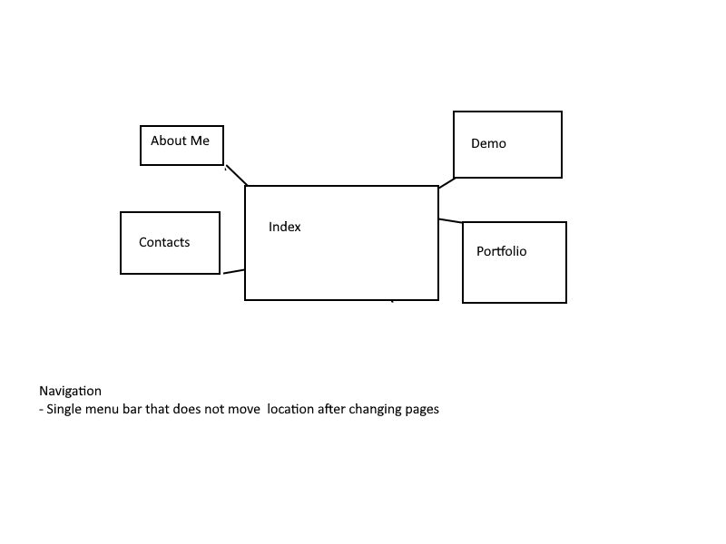
Navigation flow

Slide 6
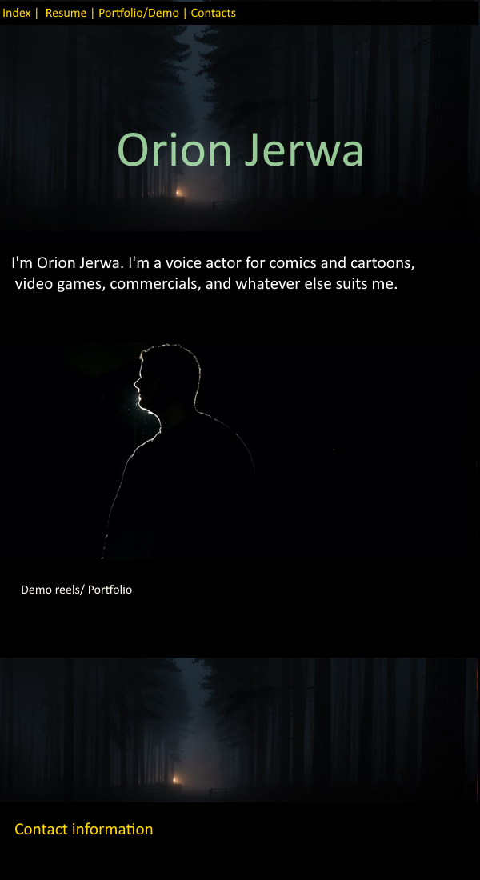
Prototypes And Design Chooses
During development of the website, we follow the design plan of the Matthew Mercer website layer out with the parallax. Using that as a example we came up with a one page design.
However over time the design would not work with the outline mission statement for the website.

Slide 7
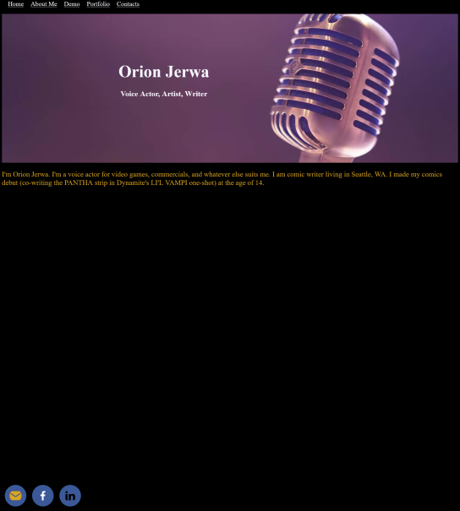
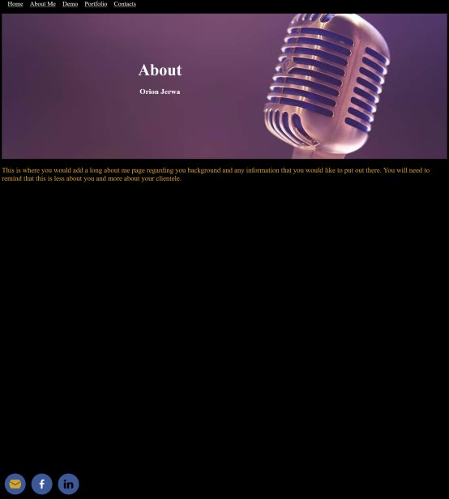
New Design
Instead of have one large webpage with all the information laid out with came to the idea of doing 5 separate pages with a fix navigation bar, which will take the user to the different pages.

Slide 8
User Testing
On Thursday March 2nd 2023 the team did user testing with two people.
The test was to evaluate
The average time to complete each task across all participants.
Participants ranking of usability and aesthetics of the site.
The percentage of participants that completed tasks below certain time frame.

Slide 9
Results continued Performance Data Summary
TASKS | % of participants performing Correctly (within benchmark) | % of participants performing Incorrectly (within benchmark) | Mean Time (minutes)
Locate to the information “about me” page. | 100 | 0 | Less than a minute
Locate the demos of Onion’s voice acting? | 100 | 0 | Less than a minute
Locate the contact information of Onion. | 100 | 0 | Less than a minute

Slide 10
Results continued Aesthetics statements
Tester recommend adding contact information in another tab rather than the bottom of the page
Aesthetics look good and color scheme is acceptable
Tester recommend adding social media icons at the top
Font size too small of easy reading. Testers recommend change font to a large font for user friendliness
No information on who website this is. Testers recommend a Banner or User’s name on all pages

Slide 11
Thank you, For your time and you corporation

